Slide 1
Adaptive Control
Automatic adjustment of controller settings to compensate for unanticipated changes in the process or the environment (“self-tuning” controller)
--- uncertainties
---nonlinearities
--- time-varying parameters
Offers significant benefits for difficult control problems

Slide 2
Examples-process changes
Catalyst behavior
Heat exchanger fouling
Startup, shutdown
Large frequent disturbances (grade or quality changes flow rate)
Ambient conditions
Programmed Adaption—
If process changes are known, measurable, or can be anticipated, use this information to adjust controller settings accordingly,
-- store different settings for different conditions

Slide 3
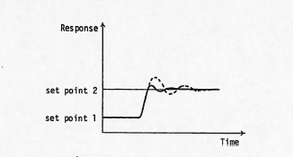
Figure: Closed-loop Process Response Before Retuning (dashed line) and After Retuning (solid line)

Slide 4
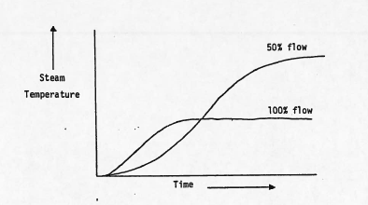
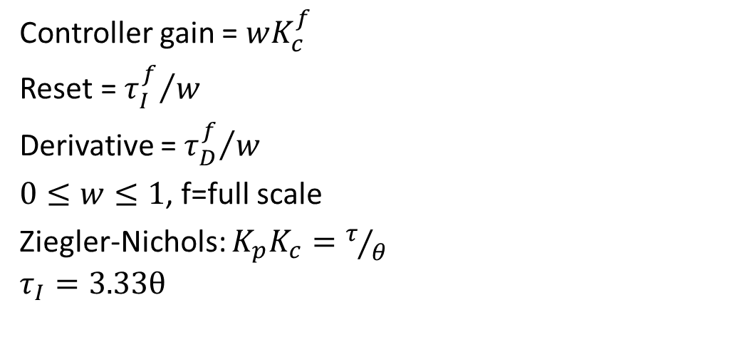
Controller gain = $wK_{c}^{f}$
Reset = ${τ_{I}^{f}}/w$
Derivative = ${τ_{D}^{f}}/w$
$0≤w≤1$, f=full scale
Ziegler-Nichols: $K_{p}K_{c}=τ/θ$
$$τ_{I}=3.33θ$$

Slide 5
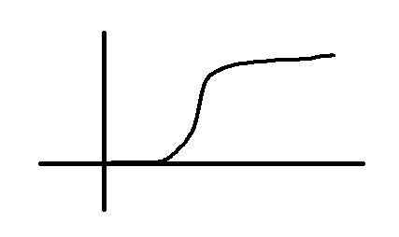

Could use periodic step tests to identify dynamics
E.g.
$$G_{p}\left(s\right)=\frac{K_{p}e^{−θs}}{1+τs}$$
Then update controller using Cohen-Coon settings
$$K_{p}K_{c}=\frac{τ}{θ}\left[1+\frac{1}{3}\frac{θ}{τ}\right]$$
$$τ_{I}=\frac{θ\left[30+3\left(θ/τ\right)\right]}{9+20\left(θ/τ\right)}$$

Slide 6
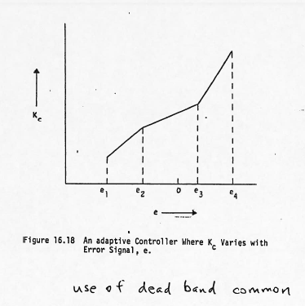

Slide 7
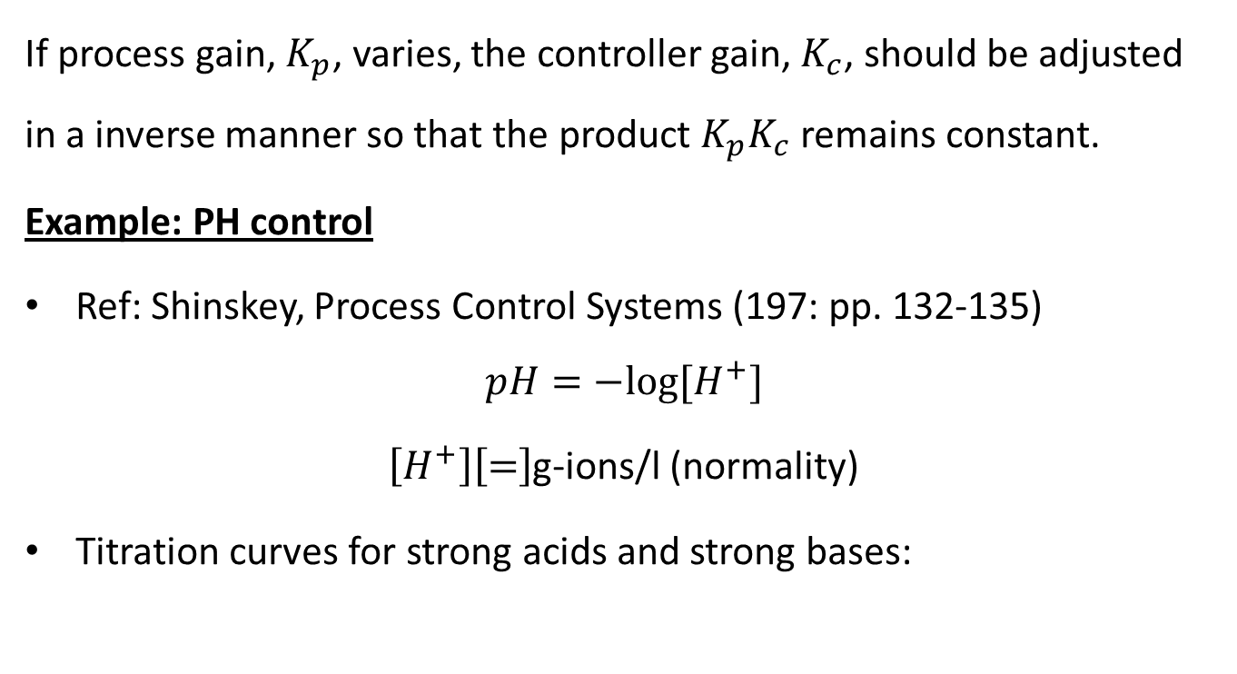
Rule of Thumb: (stability theory)
If process gain, $K_{p}$, varies, the controller gain, $K_{c}$, should be adjusted in a inverse manner so that the product $K_{p}K_{c}$ remains constant.
Example: PH control
Ref: Shinskey, Process Control Systems (197: pp. 132-135)
$$pH=−log⁡[H^{+}]$$
$\left[H^{+}\right]\left[=\right]$g-ions/l (normality)
Titration curves for strong acids and strong bases:

Slide 8
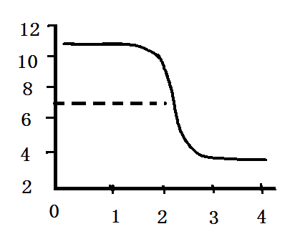
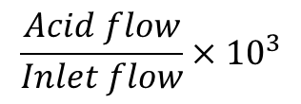
pH
$$\frac{Acid flow}{Inlet flow}×{10}^{3}$$
Process gain = slope of curve (extremely variable)
Control at pH= 7 ?

Slide 9
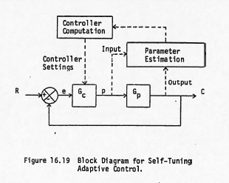

Slide 10
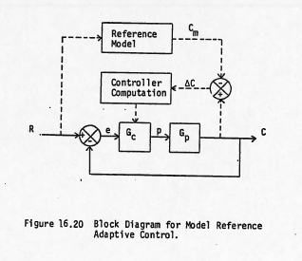

Slide 11
Commercial Adaptive Controllers(not in DCS)
(1) Leeds and Northrup
(2) Toshiba
(3) ASEA (self-tuning regulator or min variance)
(4) Foxboro(expert system)
(5) SATT/Fisher Controls(autotuner)

Slide 12
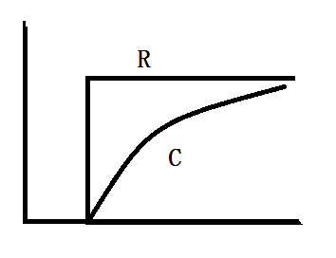
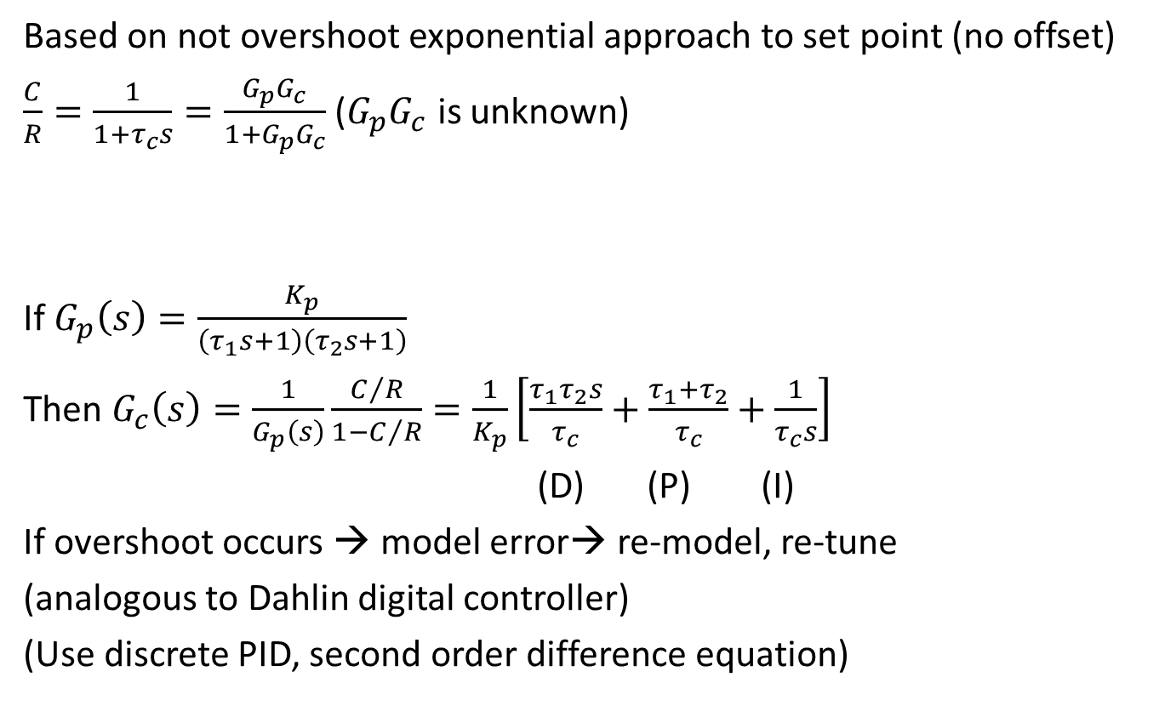
L+N Controller (Cont. Eng. Aug, 1981)
Based on not overshoot exponential approach to set point (no offset)
$\frac{C}{R}=\frac{1}{1+τ_{c}s}=\frac{G_{p}G_{c}}{1+G_{p}G_{c}}$ ($G_{p}G_{c}$ is unknown)
If $G_{p}\left(s\right)=\frac{K_{p}}{\left(τ_{1}s+1\right)\left(τ_{2}s+1\right)}$
Then $G_{c}\left(s\right)=\frac{1}{G_{p}\left(s\right)}\frac{C/R}{1−C/R}=\frac{1}{K_{p}}\left[\frac{τ_{1}τ_{2}s}{τ_{c}}+\frac{τ_{1}+τ_{2}}{τ_{c}}+\frac{1}{τ_{c}s}\right]$
(D) (P) (I)
If overshoot occurs → model error→ re-model, re-tune
(analogous to Dahlin digital controller)
(Use discrete PID, second order difference equation)

Slide 13
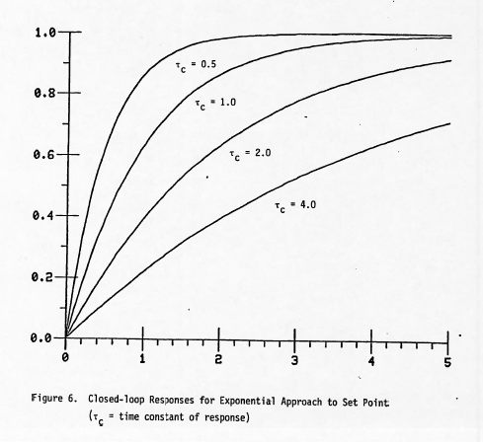

Slide 14
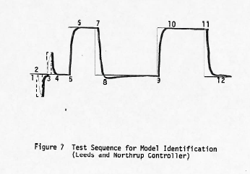

Slide 15



Many Different Possibilities
DESIGN
ESTIMATOR
$$y_{set}$$
$$u$$
$$y$$
REGULATOR
PROCESS
Estimation Methods:
Stochastic approximation
Recursive least squares
Extended least squares
Multi-stage least squares
Instrumental variance
Recursive maximum likelihood
Design Methods:
Minimum variance
LQG
Pole-placement
Phase and gain margins

Slide 16
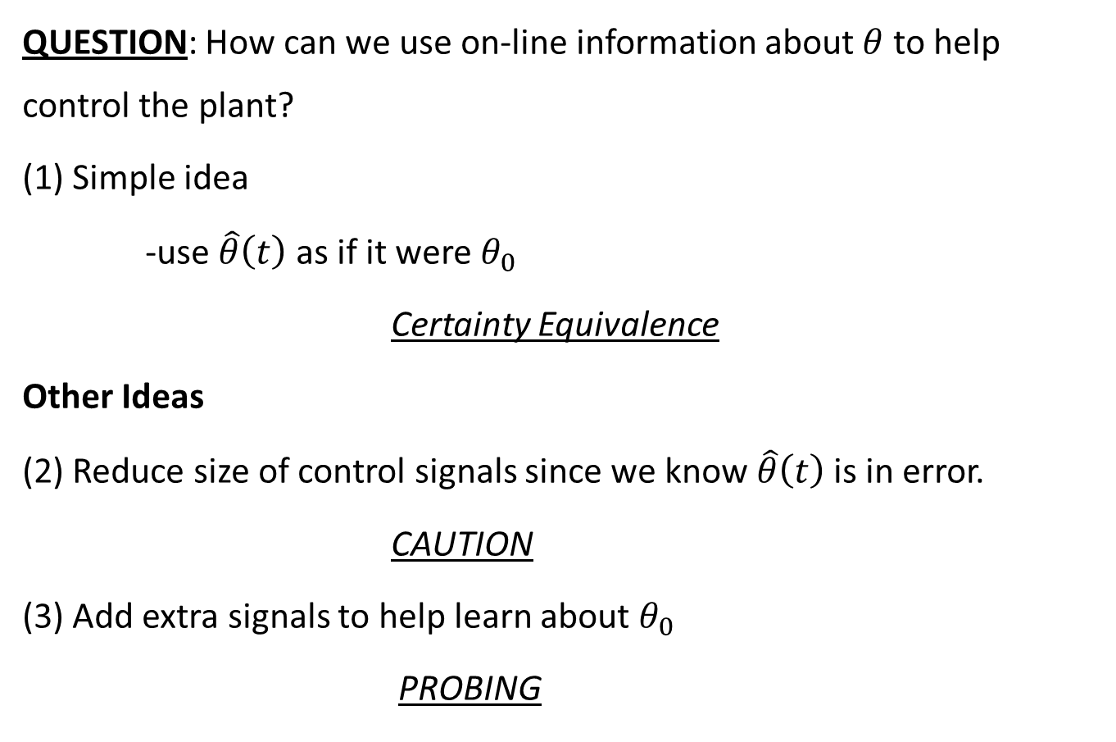
Question: How can we use on-line information about $θ$ to help control the plant?
(1) Simple idea
-use $\hat{θ}\left(t\right)$ as if it were $θ_{0}$
Certainty Equivalence
Other Ideas
(2) Reduce size of control signals since we know $\hat{θ}\left(t\right)$ is in error.
CAUTION
(3) Add extra signals to help learn about $θ_{0}$
PROBING

Slide 17

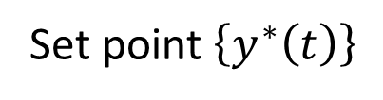




A special class of nonlinear control
$$\left\{d\left(t\right)\right\}$$
$$\left\{u\left(t\right)\right\}$$
$$\left\{y\left(t\right)\right\}$$
Plant
Linear Stochastic
Parameter Estimator
Nonlinear
$$\hat{θ}\left(t\right)$$
Control law Synthesis
Nonlinear
$$\hat{β}\left(t\right)$$
Feedback
Time Varying
Set point $\left\{y^{∗}\left(t\right)\right\}$

Slide 18
Classification of Adaptive Control Techniques
(1) explicit – model parameters estimated explicitly;
Indirect – control law obtained via model;
(2) implicit – model parameters imbedded in control law;
Direct – control law estimated directly;
Adaptive Control Algorithms
(1) On-line parameter estimation;
(2) Adaptive Control design methods based on
(a) quadratic cost functions
(b) pole placement
(c) stability theory
(3) Miscellaneous methods

Slide 19
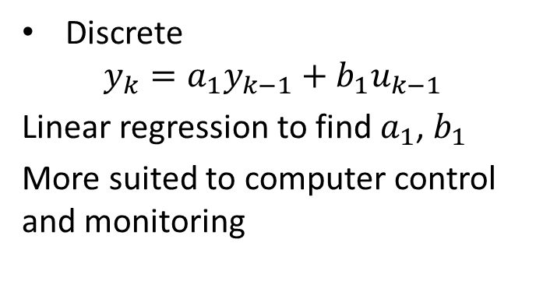
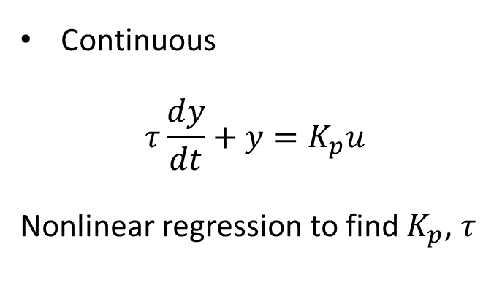
On-line Parameter Estimation
Continuous
$$τ\frac{dy}{dt}+y=K_{p}u$$
Nonlinear regression to find $K_{p}$, $τ$
Discrete
$$y_{k}=a_{1}y_{k−1}+b_{1}u_{k−1}$$
Linear regression to find $a_{1}$, $b_{1}$
More suited to computer control and monitoring
Non-sequential
Long time horizon
Batch
Off-line
Sequential
One point at a time
On-line
Continuous updating

Slide 20
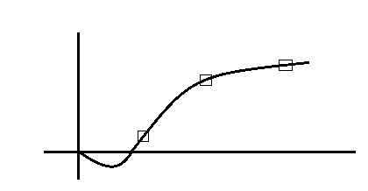
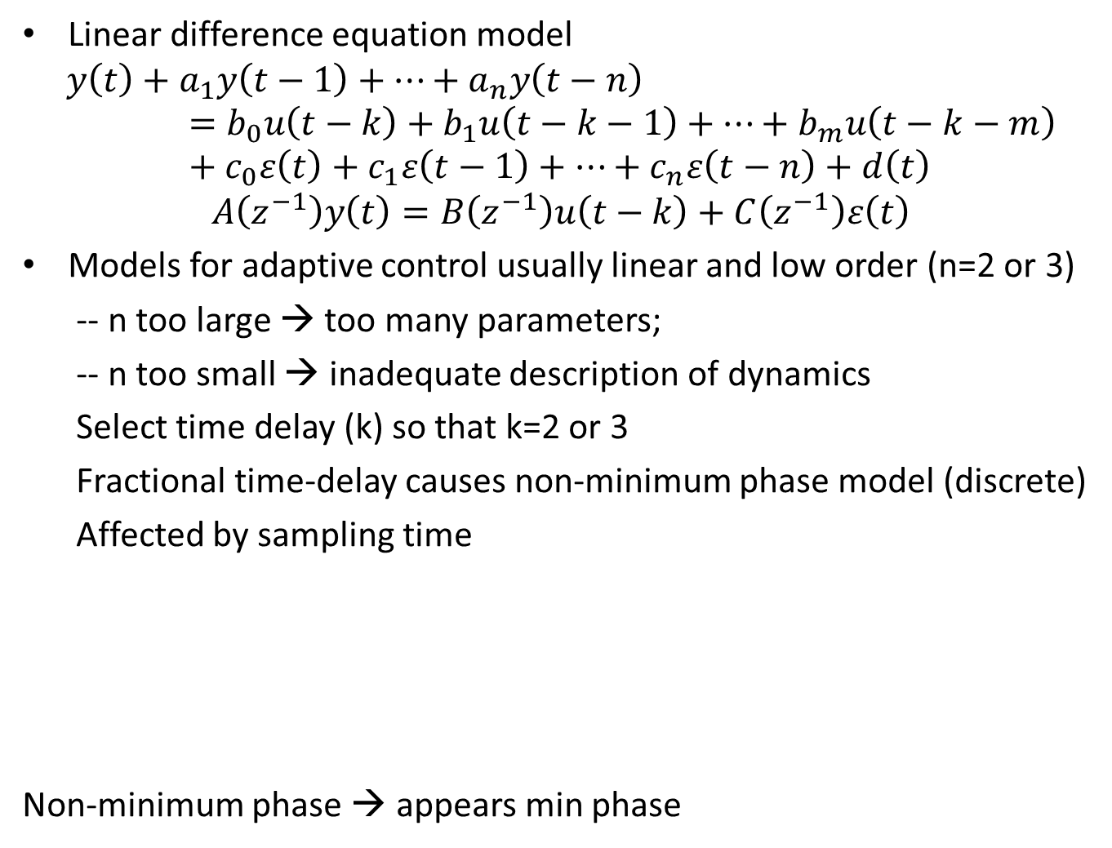
Linear difference equation model
$$y\left(t\right)+a_{1}y\left(t−1\right)+…+a_{n}y\left(t−n\right)=b_{0}u\left(t−k\right)+b_{1}u\left(t−k−1\right)+…+b_{m}u\left(t−k−m\right)+c_{0}ε\left(t\right)+c_{1}ε\left(t−1\right)+…+c_{n}ε\left(t−n\right)+d\left(t\right)$$
$$A\left(z^{−1}\right)y\left(t\right)=B\left(z^{−1}\right)u\left(t−k\right)+C\left(z^{−1}\right)ε\left(t\right)$$
Models for adaptive control usually linear and low order (n=2 or 3)
-- n too large → too many parameters;
-- n too small → inadequate description of dynamics
Select time delay (k) so that k=2 or 3
Fractional time-delay causes non-minimum phase model (discrete)
Affected by sampling time
Non-minimum phase → appears min phase

Slide 21
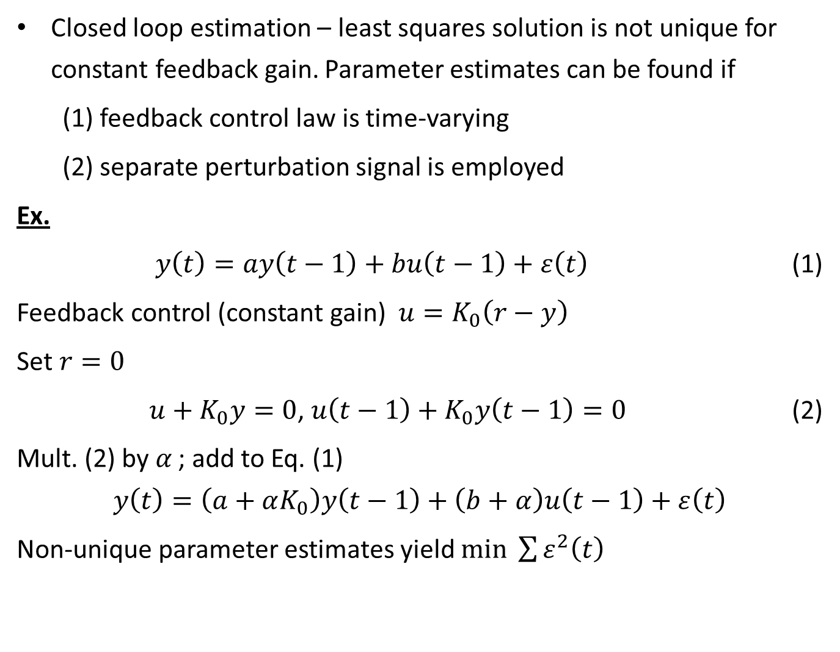
Closed loop estimation – least squares solution is not unique for constant feedback gain. Parameter estimates can be found if
(1) feedback control law is time-varying
(2) separate perturbation signal is employed
Ex.
$y\left(t\right)=ay\left(t−1\right)+bu\left(t−1\right)+ε\left(t\right)$ (1)
Feedback control (constant gain) $u=K_{0}\left(r−y\right)$
Set $r=0$
$u+K_{0}y=0$, $u\left(t−1\right)+K_{0}y\left(t−1\right)=0$ (2)
Mult. (2) by $α_{ }$; add to Eq. (1)
$$y\left(t\right)=\left(a+αK_{0}\right)y\left(t−1\right)+\left(b+α\right)u\left(t−1\right)+ε\left(t\right)$$
Non-unique parameter estimates yield $min \sum{ε^{2}\left(t\right)}$

Slide 22
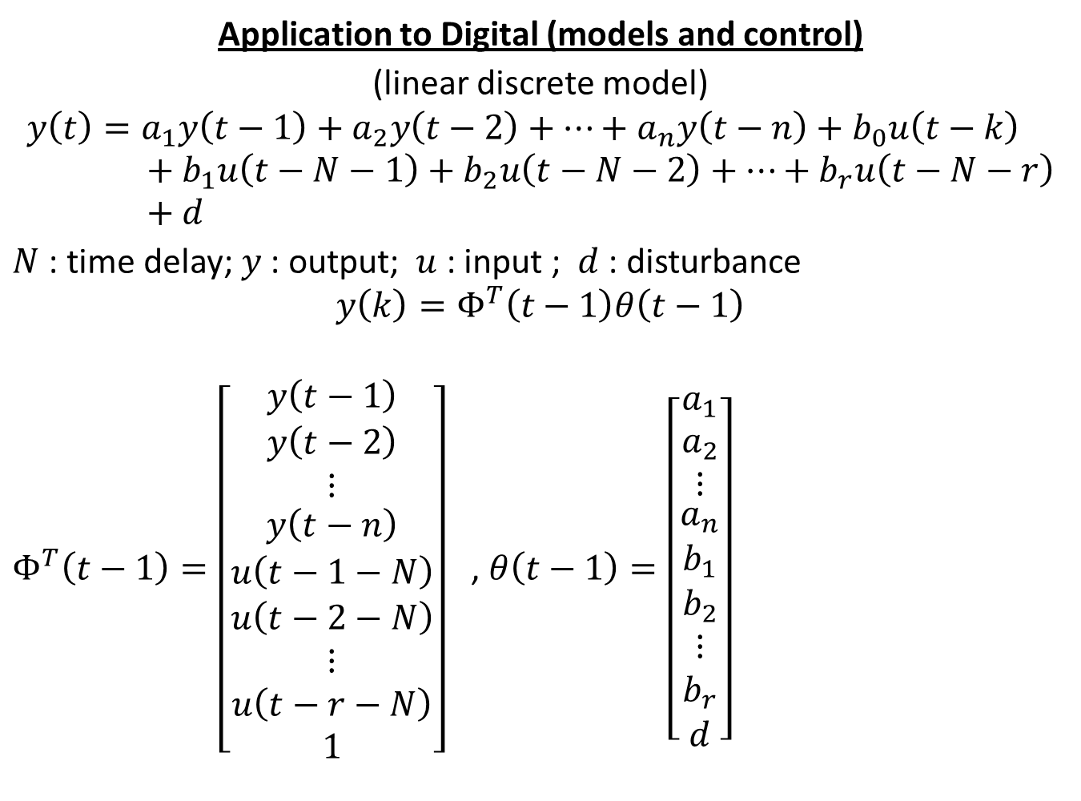
Application to Digital (models and control)
(linear discrete model)
$$y\left(t\right)=a_{1}y\left(t−1\right)+a_{2}y\left(t−2\right)+…+a_{n}y\left(t−n\right)+b_{0}u\left(t−k\right)+b_{1}u\left(t−N−1\right)+b_{2}u\left(t−N−2\right)+…+b_{r}u\left(t−N−r\right)+d$$
$N$ : time delay; $y$ : output; $u$ : input ; $d$ : disturbance
$$y\left(k\right)=Φ^{T}\left(t−1\right)θ\left(t−1\right)$$
$Φ^{T}\left(t−1\right)=\left[\begin{aligned}\begin{matrix}y\left(t−1\right) \\ y\left(t−2\right) \\ ⋮\end{matrix} \\ y\left(t−n\right) \\ u\left(t−1−N\right) \\ u\left(t−2−N\right) \\ ⋮ \\ u\left(t−r−N\right) \\ 1\end{aligned}\right]$ , $θ\left(t−1\right)=\left[\begin{aligned}\begin{matrix}a_{1} \\ a_{2} \\ ⋮\end{matrix} \\ a_{n} \\ b_{1} \\ b_{2} \\ ⋮ \\ b_{r} \\ d\end{aligned}\right]$

Slide 23
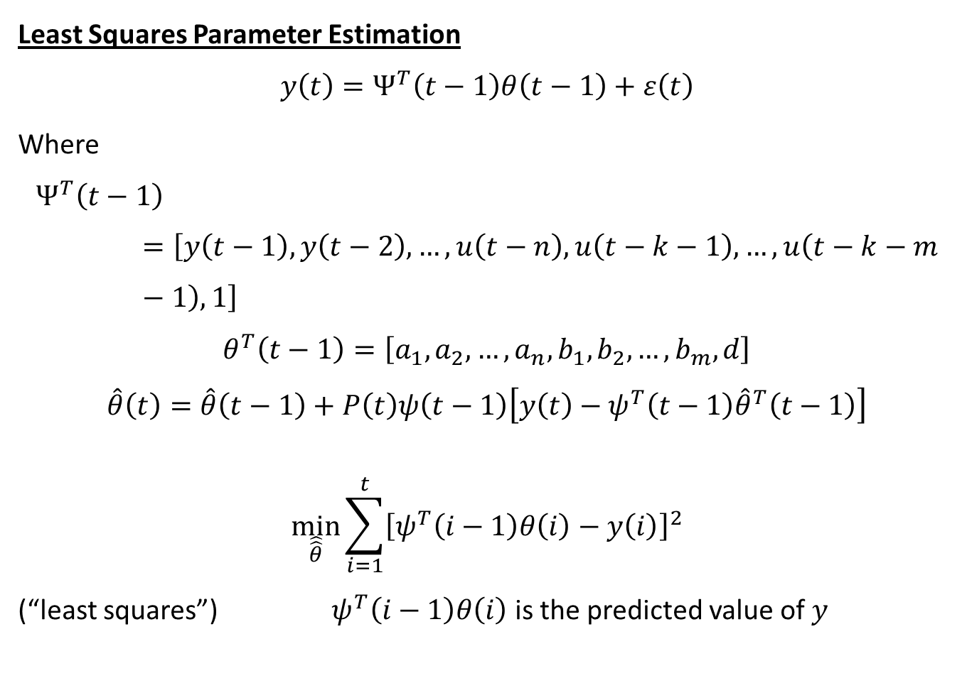
Least Squares Parameter Estimation
$$y\left(t\right)=Ψ^{T}\left(t−1\right)θ\left(t−1\right)+ε\left(t\right)$$
Where
$$Ψ^{T}\left(t−1\right)=\left[y\left(t−1\right),y\left(t−2\right),…, u\left(t−n\right), u\left(t−k−1\right),…,u\left(t−k−m−1\right),1\right]$$
$$θ^{T}\left(t−1\right)=\left[a_{1},a_{2},…,a_{n},b_{1},b_{2},…,b_{m},d\right]$$
$$\hat{θ}\left(t\right)=\hat{θ}\left(t−1\right)+P\left(t\right)ψ\left(t−1\right)\left[y\left(t\right)−ψ^{T}\left(t−1\right){\hat{θ}}^{T}\left(t−1\right)\right]$$
$$\min_{\hat{\hat{θ}}}{\sum_{i=1}^{t}{{\left[ψ^{T}\left(i−1\right)θ\left(i\right)−y\left(i\right)\right]}^{2}}}$$
(“least squares”) $ψ^{T}\left(i−1\right)θ\left(i\right)$ is the predicted value of $y$

Slide 24
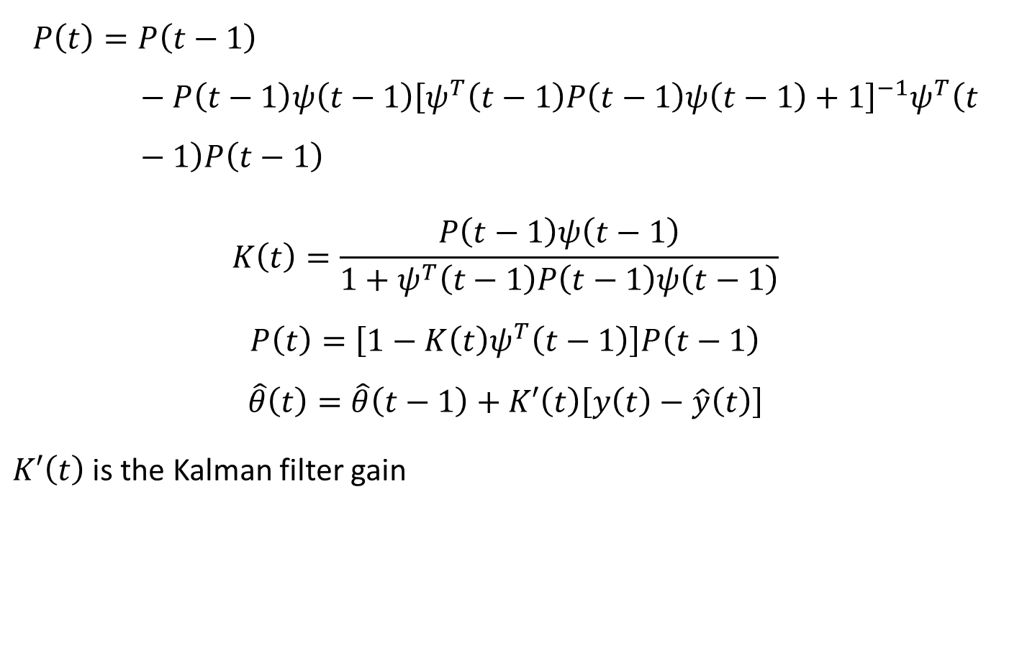
$$P\left(t\right)=P\left(t−1\right)−P\left(t−1\right)ψ\left(t−1\right){\left[ψ^{T}\left(t−1\right)P\left(t−1\right)ψ\left(t−1\right)+1\right]}^{−1}ψ^{T}\left(t−1\right)P\left(t−1\right)$$
$$K\left(t\right)=\frac{P\left(t−1\right)ψ\left(t−1\right)}{1+ψ^{T}\left(t−1\right)P\left(t−1\right)ψ\left(t−1\right)}$$
$$P\left(t\right)=\left[1−K\left(t\right)ψ^{T}\left(t−1\right)\right]P\left(t−1\right)$$
$$\hat{θ}\left(t\right)=\hat{θ}\left(t−1\right)+K′\left(t\right)\left[y\left(t\right)−\hat{y}\left(t\right)\right]$$
$K′\left(t\right)$ is the Kalman filter gain

Slide 25
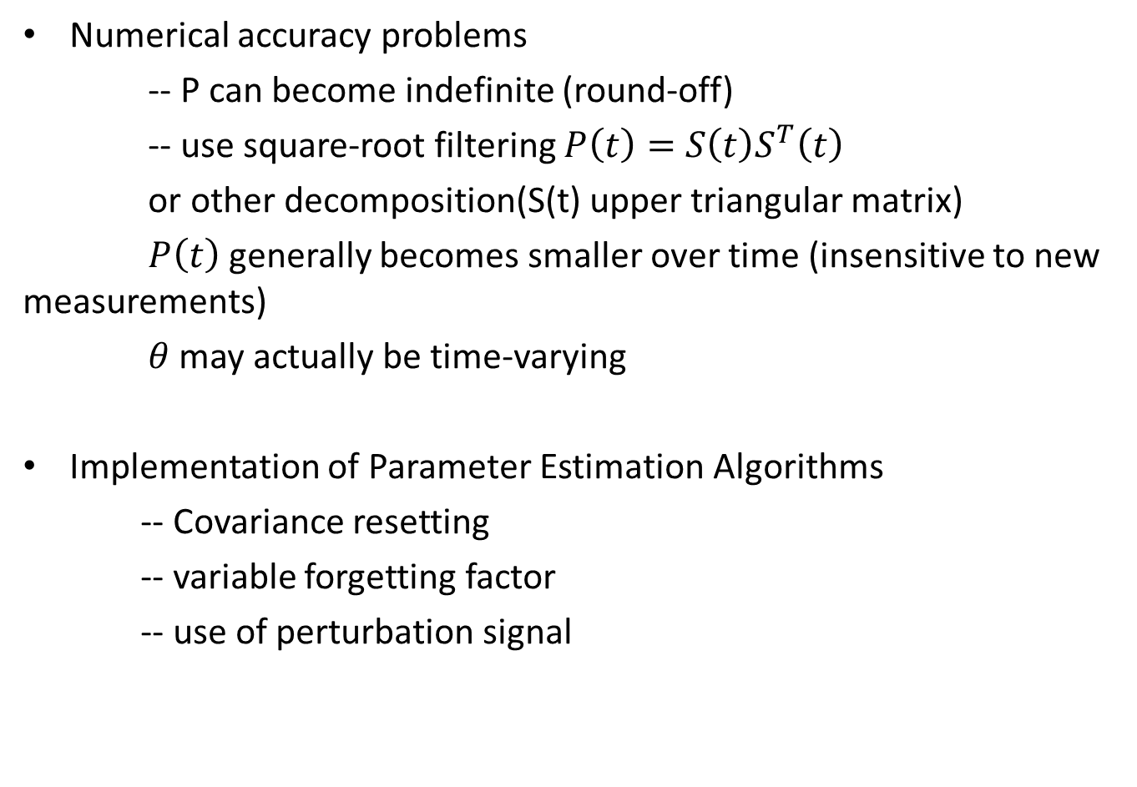
Numerical accuracy problems
-- P can become indefinite (round-off)
-- use square-root filtering $P\left(t\right)=S\left(t\right)S^{T}\left(t\right)$
or other decomposition(S(t) upper triangular matrix)
$P\left(t\right)$ generally becomes smaller over time (insensitive to new measurements)
$θ$ may actually be time-varying
Implementation of Parameter Estimation Algorithms
-- Covariance resetting
-- variable forgetting factor
-- use of perturbation signal

Slide 26
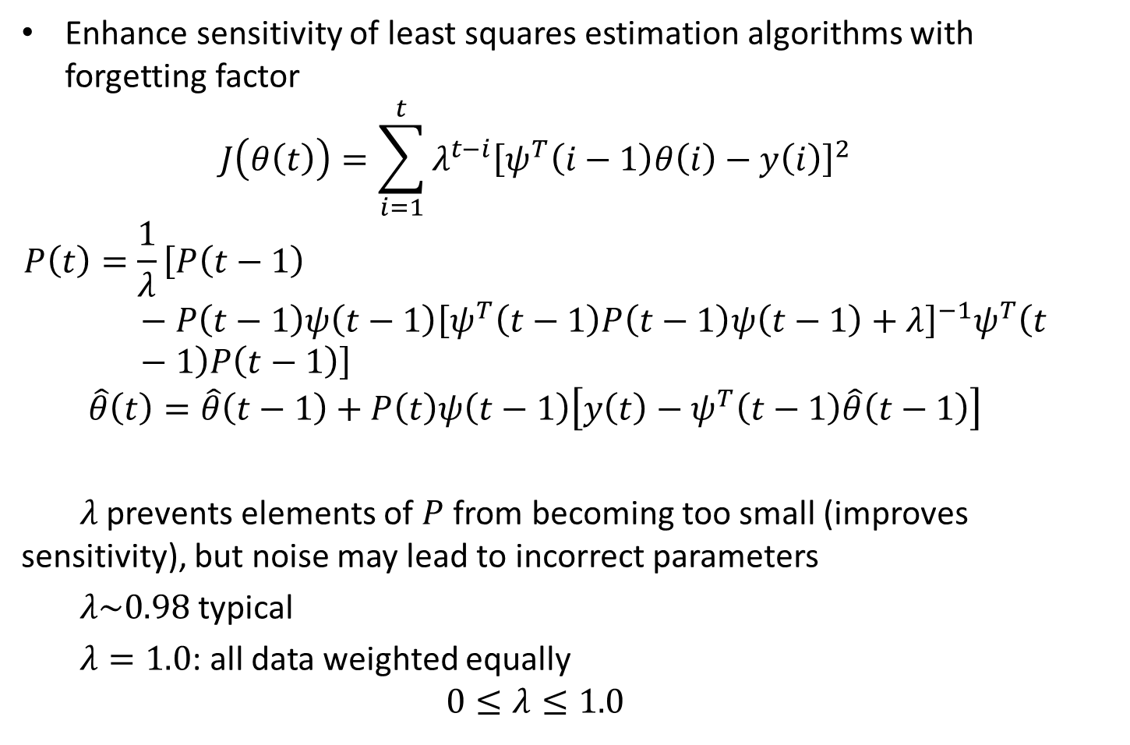
Enhance sensitivity of least squares estimation algorithms with forgetting factor
$$J\left(θ\left(t\right)\right)=\sum_{i=1}^{t}{λ^{t−i}{\left[ψ^{T}\left(i−1\right)θ\left(i\right)−y\left(i\right)\right]}^{2}}$$
$$P\left(t\right)=\frac{1}{λ}\left[P\left(t−1\right)−P\left(t−1\right)ψ\left(t−1\right){\left[ψ^{T}\left(t−1\right)P\left(t−1\right)ψ\left(t−1\right)+λ\right]}^{−1}ψ^{T}\left(t−1\right)P\left(t−1\right)\right]$$
$$\hat{θ}\left(t\right)=\hat{θ}\left(t−1\right)+P\left(t\right)ψ\left(t−1\right)\left[y\left(t\right)−ψ^{T}\left(t−1\right)\hat{θ}\left(t−1\right)\right]$$
$λ$ prevents elements of $P$ from becoming too small (improves sensitivity), but noise may lead to incorrect parameters
$λ\sim 0.98$ typical
$λ=1.0$: all data weighted equally
$$0≤λ≤1.0$$

Slide 27
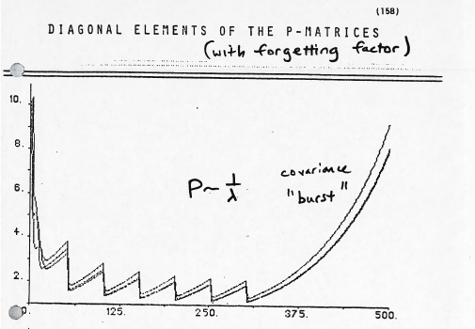

Slide 28
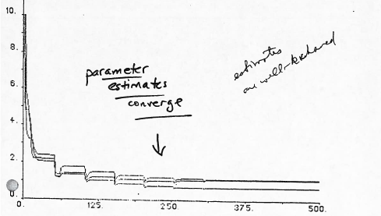

Slide 29
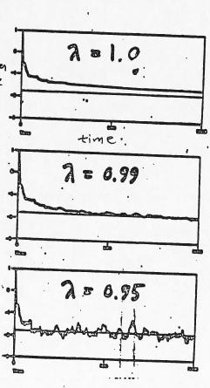
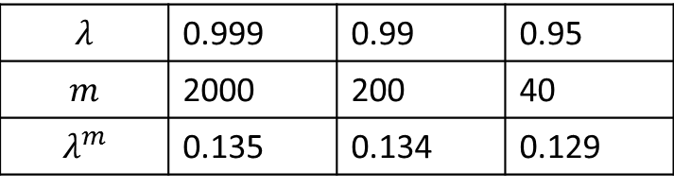
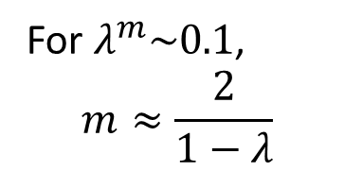
$$λ$$ | 0.999 | 0.99 | 0.95
$$m$$ | 2000 | 200 | 40
$$λ^{m}$$ | 0.135 | 0.134 | 0.129
Parameter estimate
For $λ^{m}\sim 0.1$,
$$m≈\frac{2}{1−λ}$$
Faster convergence, but more sensitive to noise

Slide 30
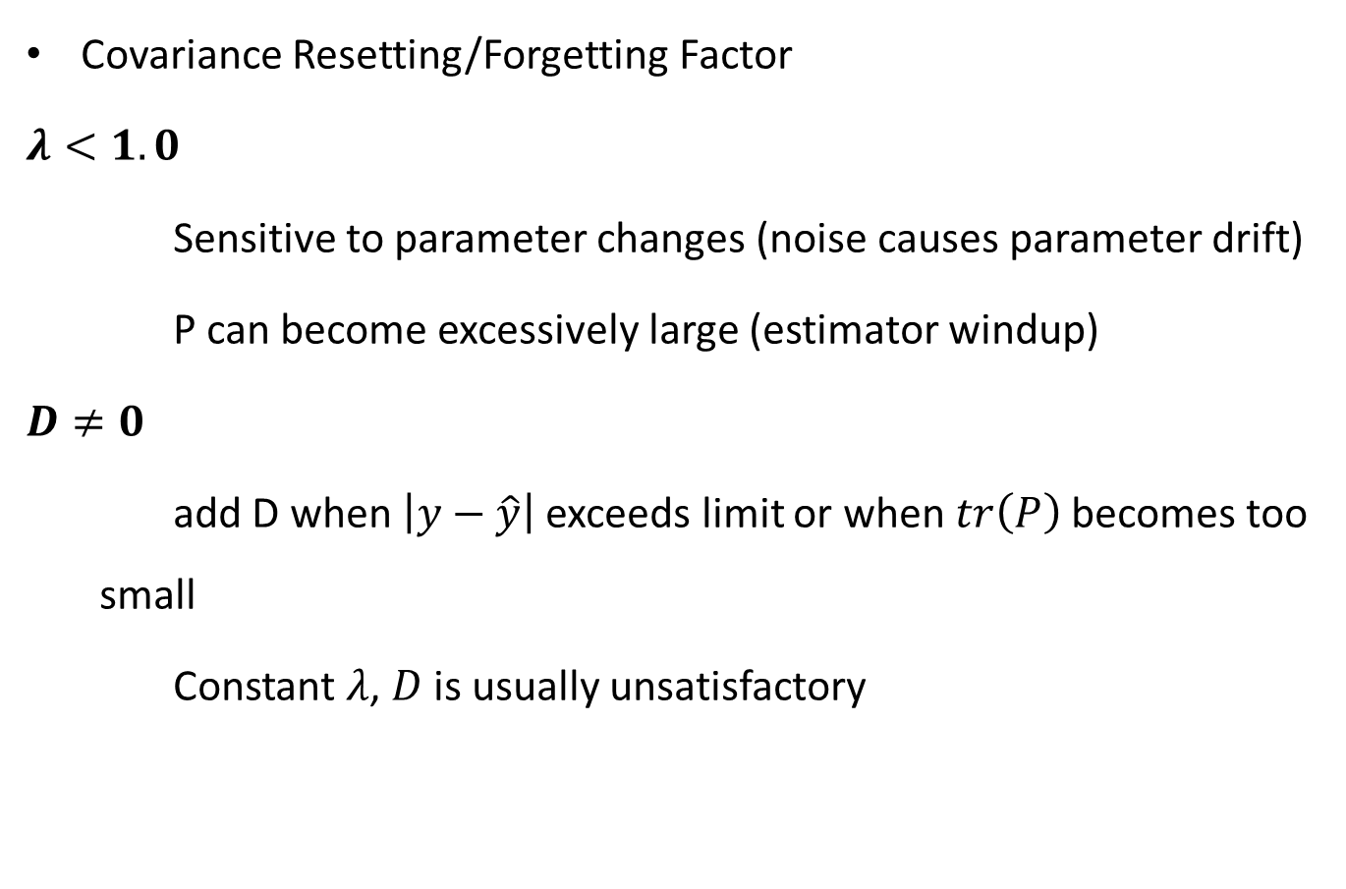
Covariance Resetting/Forgetting Factor
$λ<1.0$
Sensitive to parameter changes (noise causes parameter drift)
P can become excessively large (estimator windup)
$D≠0$
add D when $\left|y−\hat{y}\right|$ exceeds limit or when $tr\left(P\right)$ becomes too small
Constant $λ$, $D$ is usually unsatisfactory

Slide 31
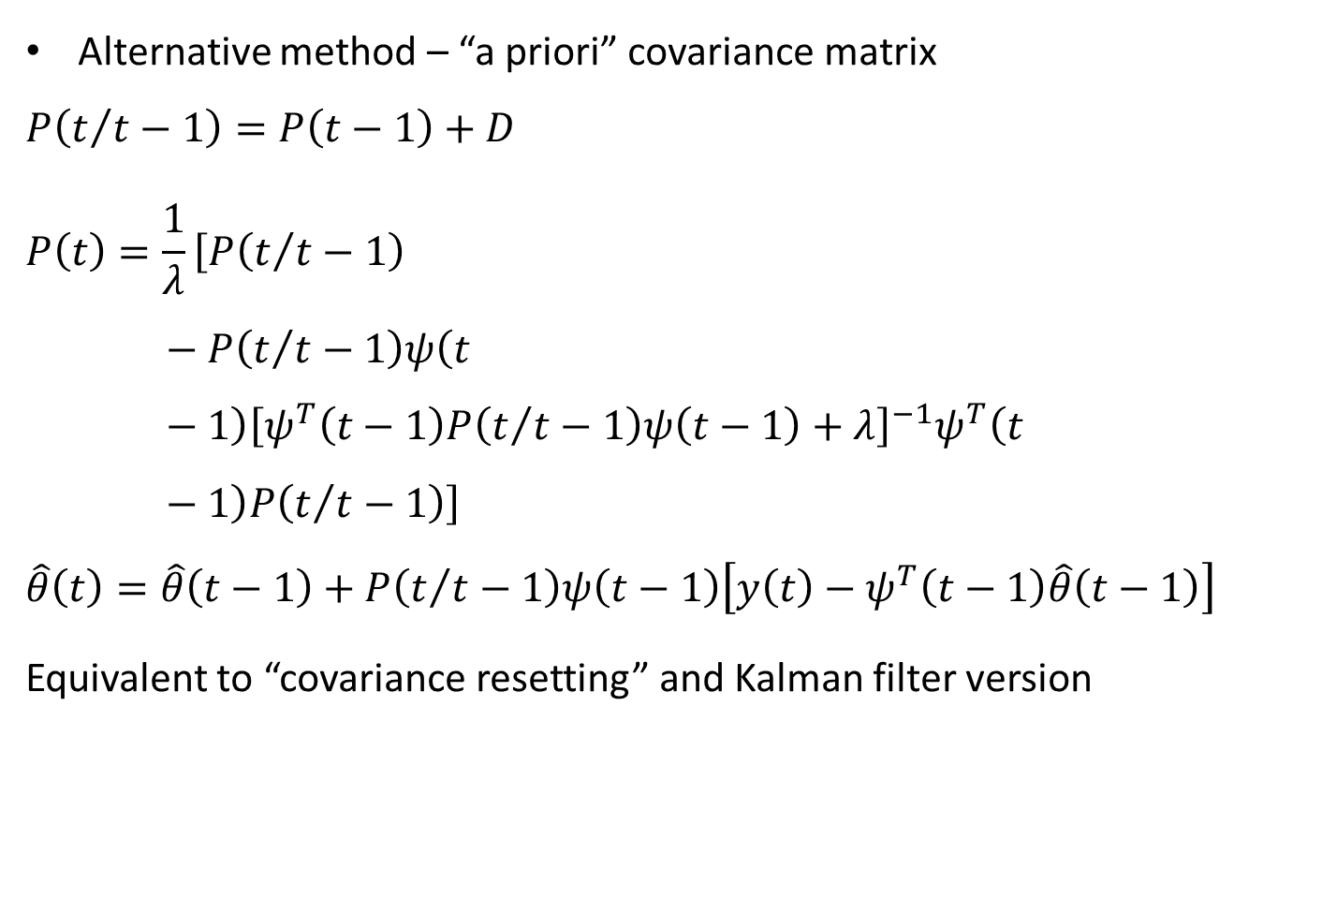
Alternative method – “a priori” covariance matrix
$$P\left(t/{t−1}\right)=P\left(t−1\right)+D$$
$$P\left(t\right)=\frac{1}{λ}\left[P\left(t/{t−1}\right)−P\left(t/{t−1}\right)ψ\left(t−1\right){\left[ψ^{T}\left(t−1\right)P\left(t/{t−1}\right)ψ\left(t−1\right)+λ\right]}^{−1}ψ^{T}\left(t−1\right)P\left(t/{t−1}\right)\right]$$
$$\hat{θ}\left(t\right)=\hat{θ}\left(t−1\right)+P\left(t/{t−1}\right)ψ\left(t−1\right)\left[y\left(t\right)−ψ^{T}\left(t−1\right)\hat{θ}\left(t−1\right)\right]$$
Equivalent to “covariance resetting” and Kalman filter version

Slide 32
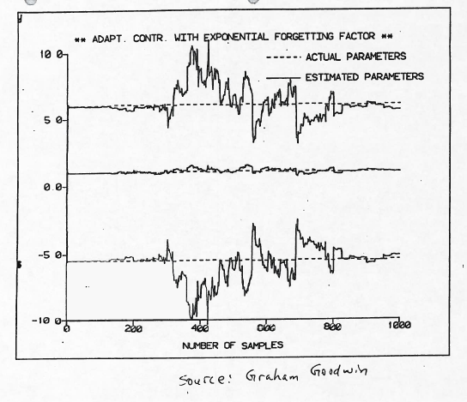

Slide 33
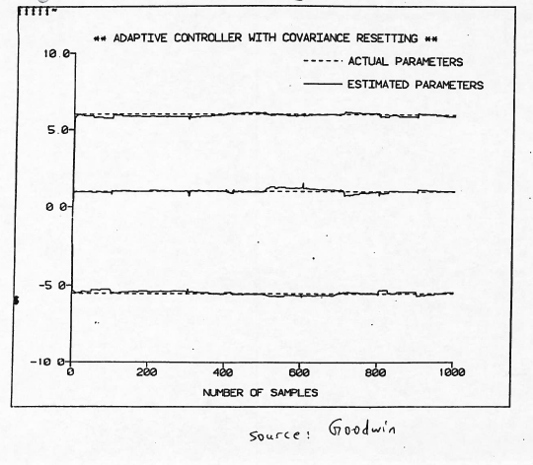

Slide 34
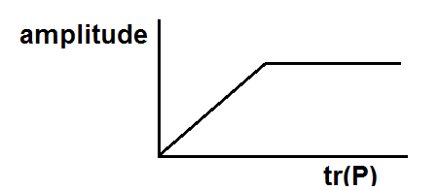
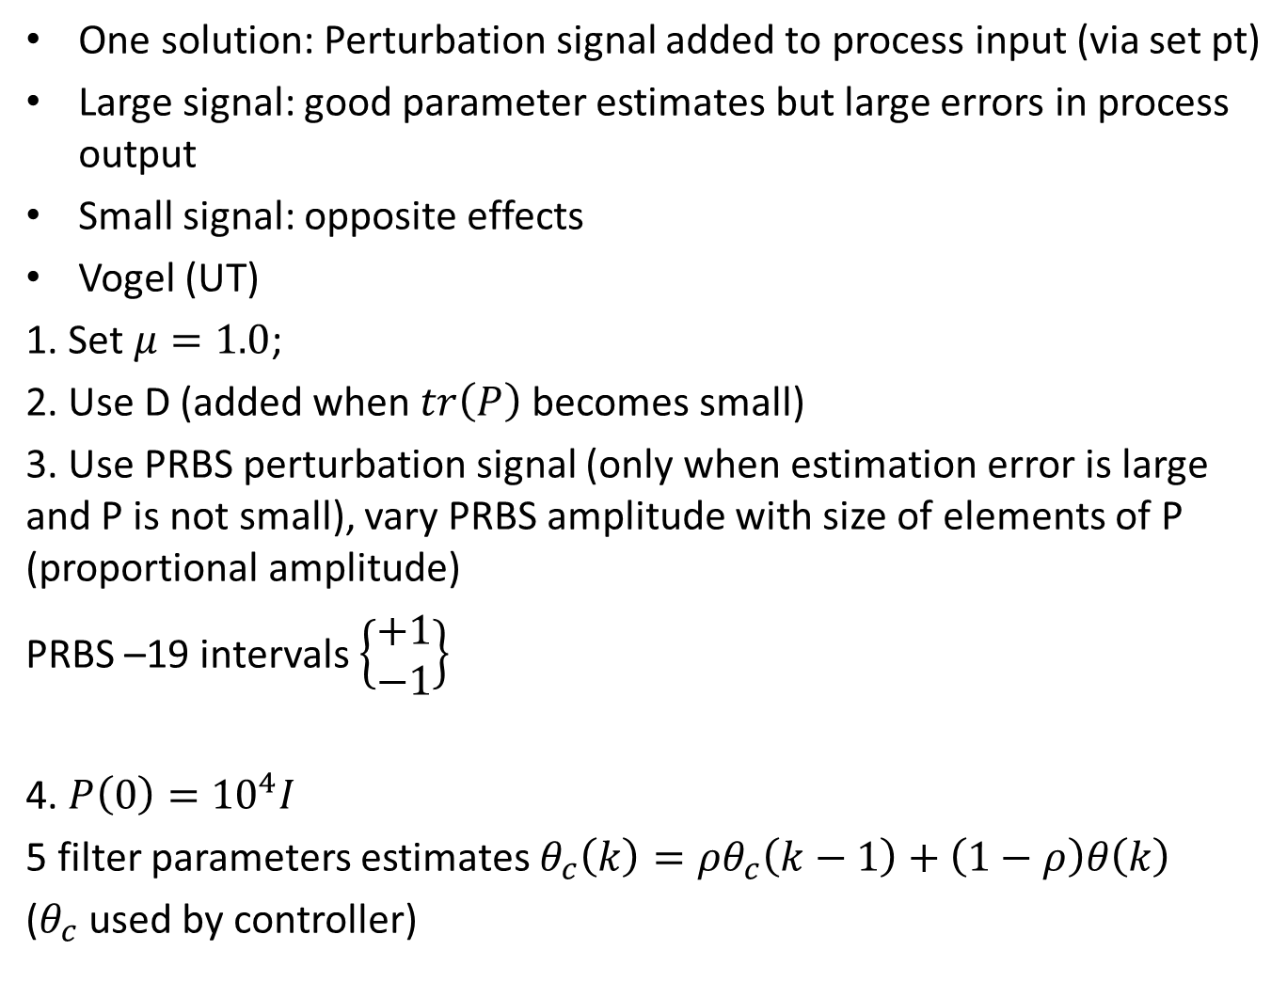
One solution: Perturbation signal added to process input (via set pt)
Large signal: good parameter estimates but large errors in process output
Small signal: opposite effects
Vogel (UT)
1. Set $μ=1.0$;
2. Use D (added when $tr\left(P\right)$ becomes small)
3. Use PRBS perturbation signal (only when estimation error is large and P is not small), vary PRBS amplitude with size of elements of P (proportional amplitude)
PRBS –19 intervals $\left\{\begin{aligned}+1 \\ −1\end{aligned}\right\}$
4. $P\left(0\right)={10}^{4}I$
5 filter parameters estimates $θ_{c}\left(k\right)=ρθ_{c}\left(k−1\right)+\left(1−ρ\right)θ\left(k\right)$
($θ_{c}$ used by controller)

Slide 35
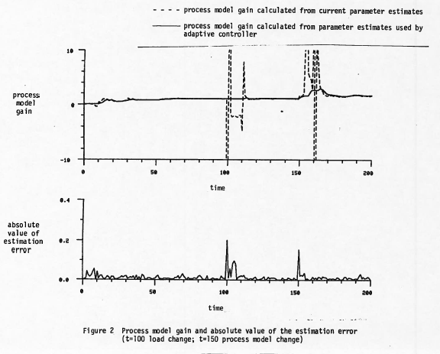

Slide 36
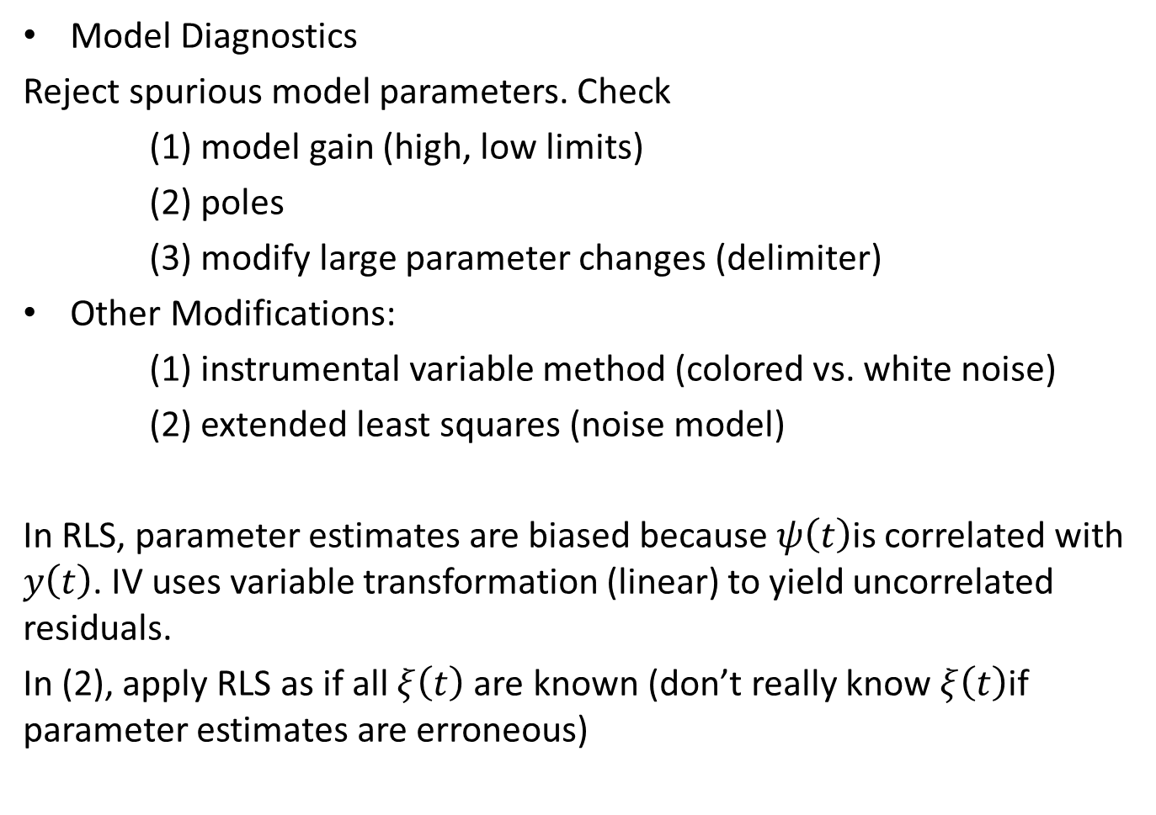
Model Diagnostics
Reject spurious model parameters. Check
(1) model gain (high, low limits)
(2) poles
(3) modify large parameter changes (delimiter)
Other Modifications:
(1) instrumental variable method (colored vs. white noise)
(2) extended least squares (noise model)
In RLS, parameter estimates are biased because $ψ\left(t\right)$is correlated with $y\left(t\right)$. IV uses variable transformation (linear) to yield uncorrelated residuals.
In (2), apply RLS as if all $ξ\left(t\right)$ are known (don’t really know $ξ\left(t\right)$if parameter estimates are erroneous)

Slide 37
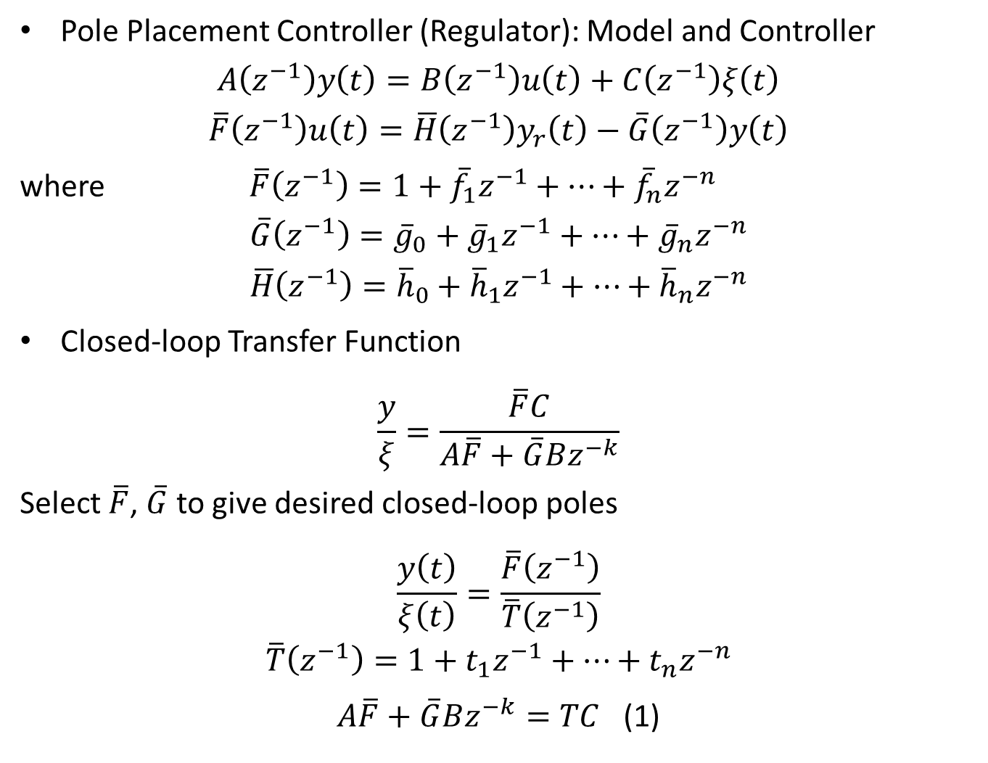
Pole Placement Controller (Regulator): Model and Controller
$$A\left(z^{−1}\right)y\left(t\right)=B\left(z^{−1}\right)u\left(t\right)+C\left(z^{−1}\right)ξ\left(t\right)$$
$$\overline{F}\left(z^{−1}\right)u\left(t\right)=\overline{H}\left(z^{−1}\right)y_{r}\left(t\right)−\overline{G}\left(z^{−1}\right)y\left(t\right)$$
where $\overline{F}\left(z^{−1}\right)=1+{\overline{f}}_{1}z^{−1}+…+{\overline{f}}_{n}z^{−n}$
$$\overline{G}\left(z^{−1}\right)={\overline{g}}_{0}+{\overline{g}}_{1}z^{−1}+…+{\overline{g}}_{n}z^{−n}$$
$$\overline{H}\left(z^{−1}\right)={\overline{h}}_{0}+{\overline{h}}_{1}z^{−1}+…+{\overline{h}}_{n}z^{−n}$$
Closed-loop Transfer Function
$$\frac{y}{ξ}=\frac{\overline{F}C}{A\overline{F}+\overline{G}Bz^{−k}}$$
Select $\overline{F}$, $\overline{G}$ to give desired closed-loop poles
$$\frac{y\left(t\right)}{ξ\left(t\right)}=\frac{\overline{F}\left(z^{−1}\right)}{\overline{T}\left(z^{−1}\right)}$$
$$\overline{T}\left(z^{−1}\right)=1+t_{1}z^{−1}+…+t_{n}z^{−n}$$
$A\overline{F}+\overline{G}Bz^{−k}=TC$ (1)

Slide 38
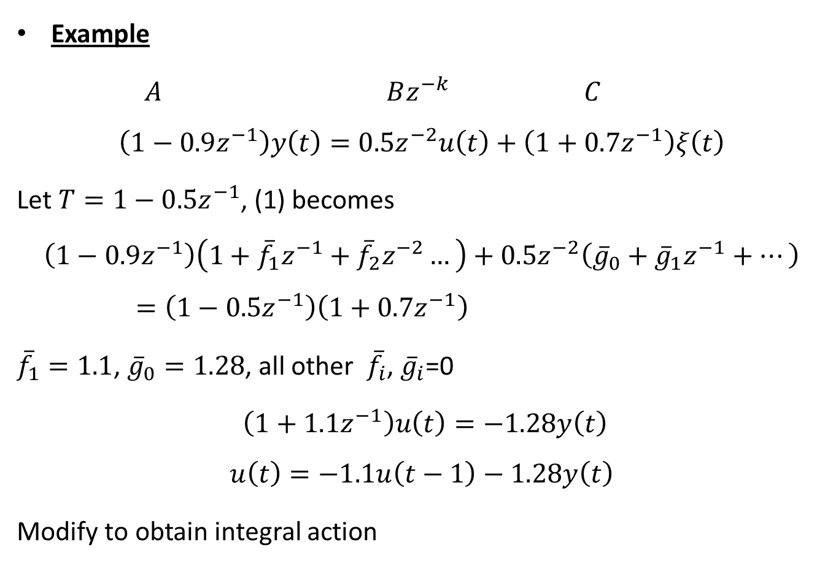
Example
$A$ $Bz^{−k}$ $C$
$$\left(1−0.9z^{−1}\right)y\left(t\right)=0.5z^{−2}u\left(t\right)+\left(1+0.7z^{−1}\right)ξ\left(t\right)$$
Let $T=1−0.5z^{−1}$, (1) becomes
$$\left(1−0.9z^{−1}\right)\left(1+{\overline{f}}_{1}z^{−1}+{\overline{f}}_{2}z^{−2}…\right)+0.5z^{−2}\left({\overline{g}}_{0}+{\overline{g}}_{1}z^{−1}+…\right)=\left(1−0.5z^{−1}\right)\left(1+0.7z^{−1}\right)$$
${\overline{f}}_{1}=1.1$, ${\overline{g}}_{0}=1.28$, all other ${\overline{f}}_{i}$, ${\overline{g}}_{i}$=0
$\left(1+1.1z^{−1}\right)u\left(t\right)=−1.28y\left(t\right)$
$$u\left(t\right)=−1.1u\left(t−1\right)−1.28y\left(t\right)$$
Modify to obtain integral action

Slide 39
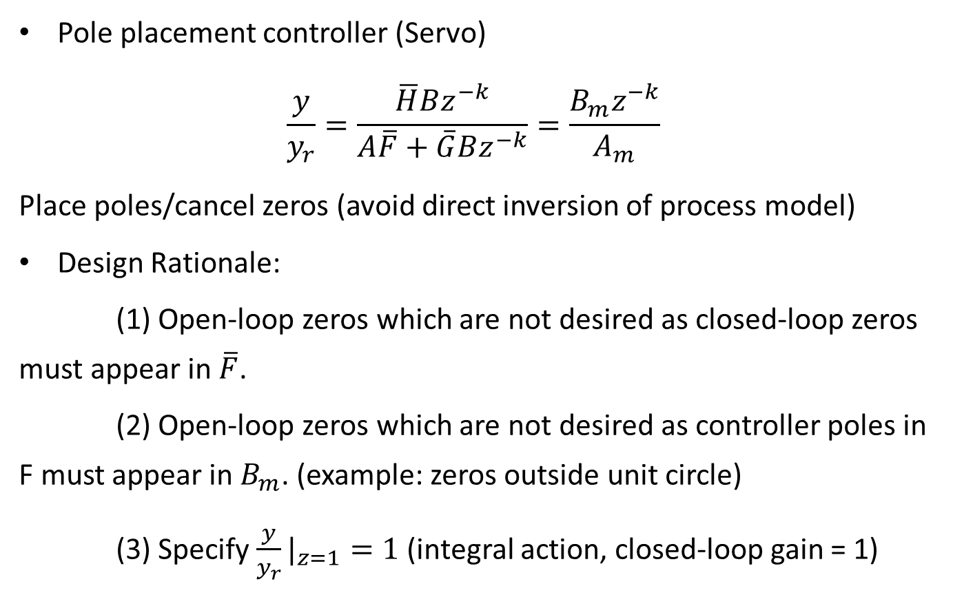
Pole placement controller (Servo)
$$\frac{y}{y_{r}}=\frac{\overline{H}Bz^{−k}}{A\overline{F}+\overline{G}Bz^{−k}}=\frac{B_{m}z^{−k}}{A_{m}}$$
Place poles/cancel zeros (avoid direct inversion of process model)
Design Rationale:
(1) Open-loop zeros which are not desired as closed-loop zeros must appear in $\overline{F}$.
(2) Open-loop zeros which are not desired as controller poles in F must appear in $B_{m}$. (example: zeros outside unit circle)
(3) Specify ${\frac{y}{y_{r}}|}_{z=1}=1$ (integral action, closed-loop gain = 1)

Slide 40
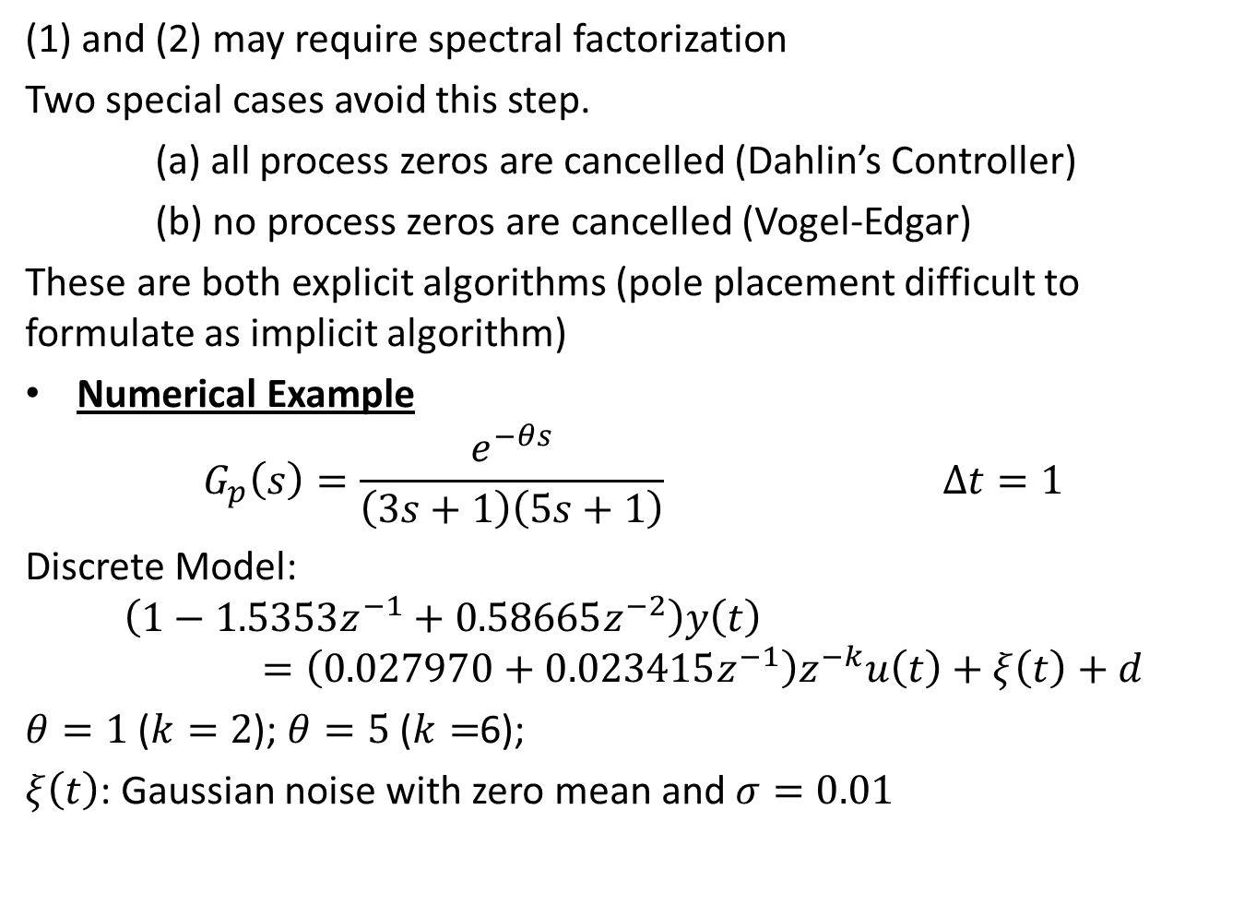
(1) and (2) may require spectral factorization
Two special cases avoid this step.
(a) all process zeros are cancelled (Dahlin’s Controller)
(b) no process zeros are cancelled (Vogel-Edgar)
These are both explicit algorithms (pole placement difficult to formulate as implicit algorithm)
Numerical Example
$$G_{p}\left(s\right)=\frac{e^{−θs}}{\left(3s+1\right)\left(5s+1\right)} Δt=1$$
Discrete Model:
$$\left(1−1.5353z^{−1}+0.58665z^{−2}\right)y\left(t\right)=\left(0.027970+0.023415z^{−1}\right)z^{−k}u\left(t\right)+ξ\left(t\right)+d$$
$θ=1$ ($k=2$); $θ=5$ ($k=$6);
$ξ\left(t\right)$: Gaussian noise with zero mean and $σ=0.01$

Slide 41
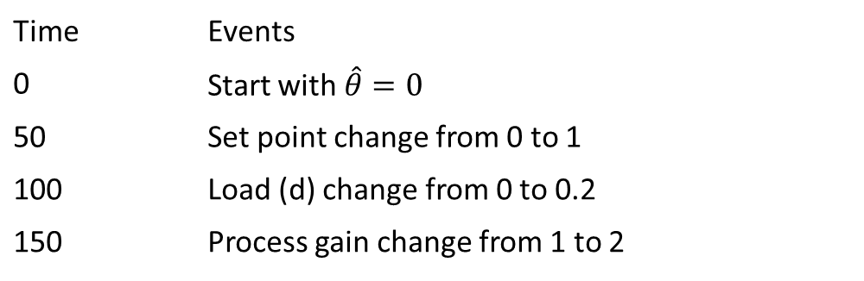
Simulation Conditions
Time | Events
0 | Start with $\hat{θ}=0$
50 | Set point change from 0 to 1
100 | Load (d) change from 0 to 0.2
150 | Process gain change from 1 to 2

Slide 42
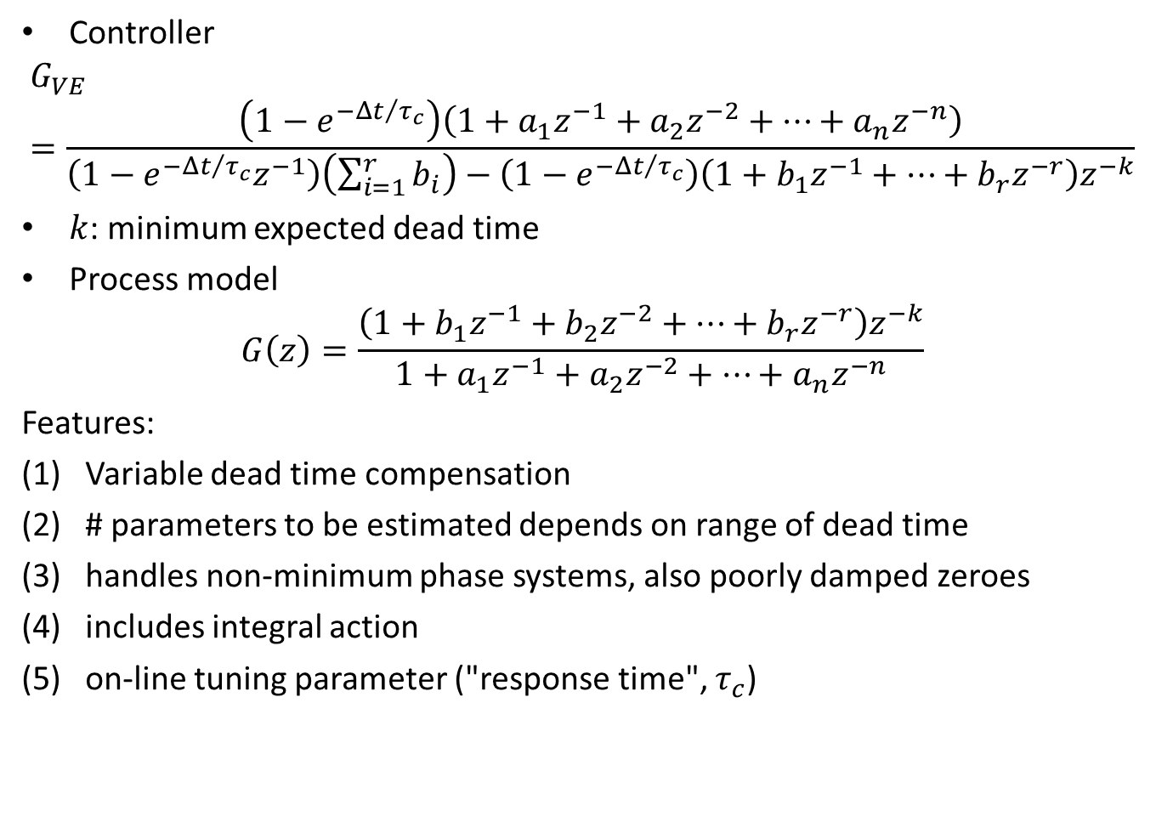
Controller
$$G_{VE}=\frac{\left(1−e^{{−Δt}/{τ_{c}}}\right)\left(1+a_{1}z^{−1}+a_{2}z^{−2}+…+a_{n}z^{−n}\right)}{\left(1−e^{{−Δt}/{τ_{c}}}z^{−1}\right)\left(\sum_{i=1}^{r}{b_{i}}\right)−\left(1−e^{{−Δt}/{τ_{c}}}\right)\left(1+b_{1}z^{−1}+…+b_{r}z^{−r}\right)z^{−k}}$$
$k$: minimum expected dead time
Process model
$$G\left(z\right)=\frac{\left(1+b_{1}z^{−1}+b_{2}z^{−2}+…+b_{r}z^{−r}\right)z^{−k}}{1+a_{1}z^{−1}+a_{2}z^{−2}+…+a_{n}z^{−n}}$$
Features:
Variable dead time compensation
# parameters to be estimated depends on range of dead time
handles non-minimum phase systems, also poorly damped zeroes
includes integral action
on-line tuning parameter ("response time", $τ_{c}$)

Slide 43
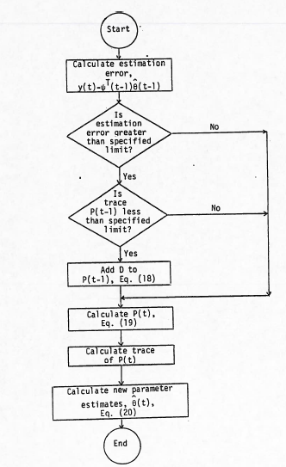
Figure: Flow Chart for the Parameter Estimation Algorithm

Slide 44
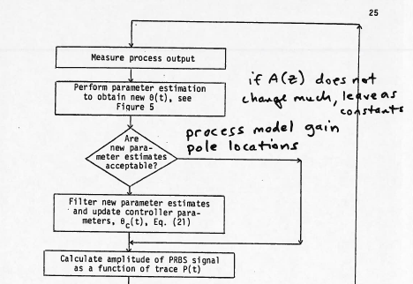
Flow Chart for Adaptive Controller/Dead (Time compensator)

Slide 45
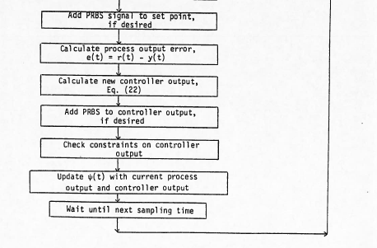

Slide 46
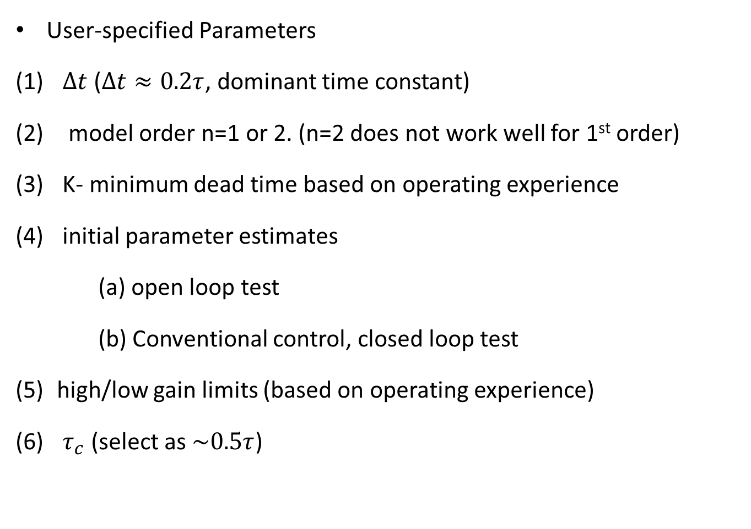
User-specified Parameters
$Δt$ ($Δt≈0.2τ$, dominant time constant)
model order n=1 or 2. (n=2 does not work well for 1st order)
K- minimum dead time based on operating experience
initial parameter estimates
(a) open loop test
(b) Conventional control, closed loop test
high/low gain limits (based on operating experience)
$τ_{c}$ (select as $\sim 0.5τ$)

Slide 47


Slide 48


Slide 49


Slide 50


Slide 51


Slide 52

Figure 7 Process Diagram for Control of Condenser Outlet Temperature (Distillation Column Provides the Disturbance)
Column: MeOH –H2O
8 Seive trays; Thermo siphon re-boiler; constant pressure

Slide 53


Slide 54


Slide 55


Slide 56


